Slide 1

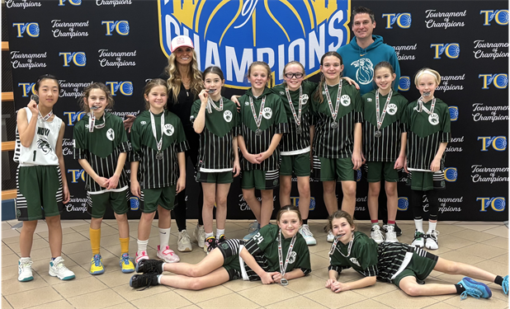

Girls’ 3rd – 8th Grades Training — Spring 2026
Small group sizes (max 25)
Trainers: Novi HS and Novi
Cats coaches
All 4 sessions for $100
Each session will focus on a particular skillset
Dates / Topics:
Thursday, April 23 — Ball Handling
Thursday, April 30 — Shooting and Scoring (1-on-1 and 2-on-2)
Thursday, May 7 — Fast Break
Thursday, May 14 — Defense and Scrimmages
Location: Orchard Hills Elementary
(41900 Quince, Novi)
Times — 6:30 to 8:00 PM
Registration and Pricing:
Register for all 4 sessions for just $100
Maximum of 25 participants per session
Questions / Info: Contact Matt Thibaudeau (313) 570-4084
Discount for Novi Cats rostered winter team players
Please register in advance at:
www.novicatsbasketball.com
Check us out on facebook

